Slide 1
Netflix Content Strategy Case Study
Insight and Recommendations for Optimal Content Engagement By: Moulid Ismail Jan 2025

Slide 2
Brief Overview:
o Problem: Netflix aims to close the gap between top-rated IMDb genres and its highest-viewed genres by analyzing streaming data and viewer trends
o Goal: Identify content strategies for improved viewer engagement and retention.
o Context: Netflix operates in a competitive streaming market.
o Approach: Data-driven insights from IMDb, Netflix Titles, and Official Netflix Viewership data.

Slide 3
Dataset Overview:
· Datasets Used:
o IMDb Top Rated Titles: Title, Genres, Average ratings, Type, release year.
o Netflix Titles: Genre, type, Release year.
o Official Netflix Viewership Data: Title, Genre, Type, Weekly hours viewed.
· Actions Taken:
o Cleaned and merged datasets.
o Standardized genre and title columns.
o Mapped trends over time.

Slide 4
Key Metrics:
· Quantitative:
o Weekly watch hours.
o IMDb ratings.
o Trends (2007–2024).
· Qualitative:
o Alignment of top genres with Netflix’s catalog.
o Viewer retention linked to genre popularity.

Slide 5
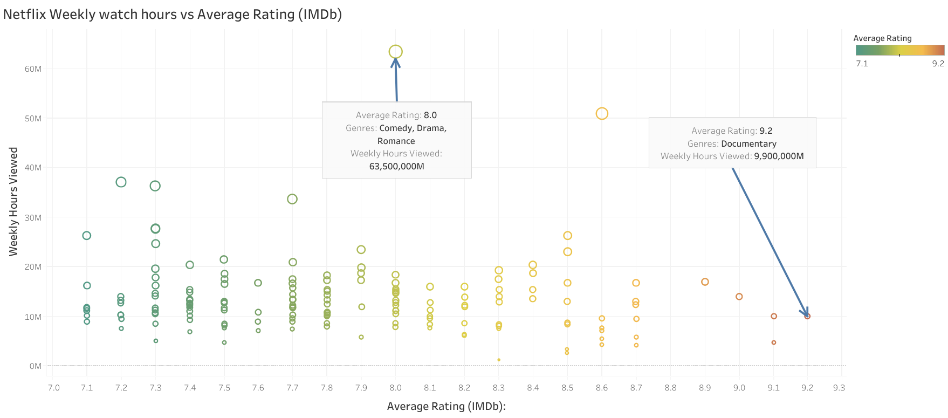
Top Genres (IMDB Rating & Weekly Wach Hours)
Key Insight: Investment in emotionally engaging genres yields high viewer retention.

Slide 6
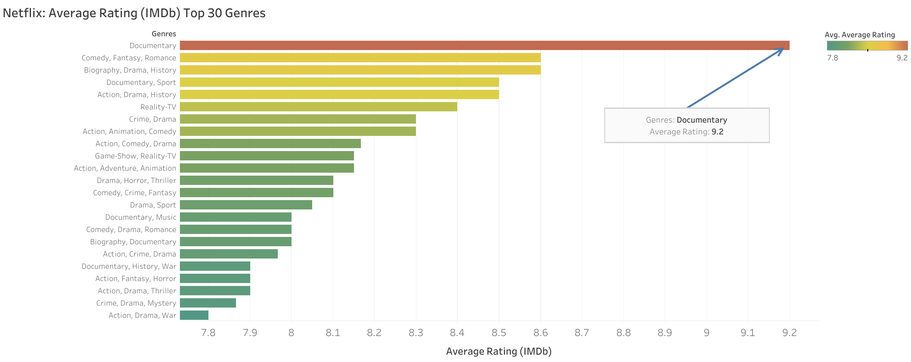
Top 30 Genres (IMDb Rating )
Key Insight: Critical acclaim (e.g., Documentaries) may require targeted marketing for broader appeal.

Slide 7
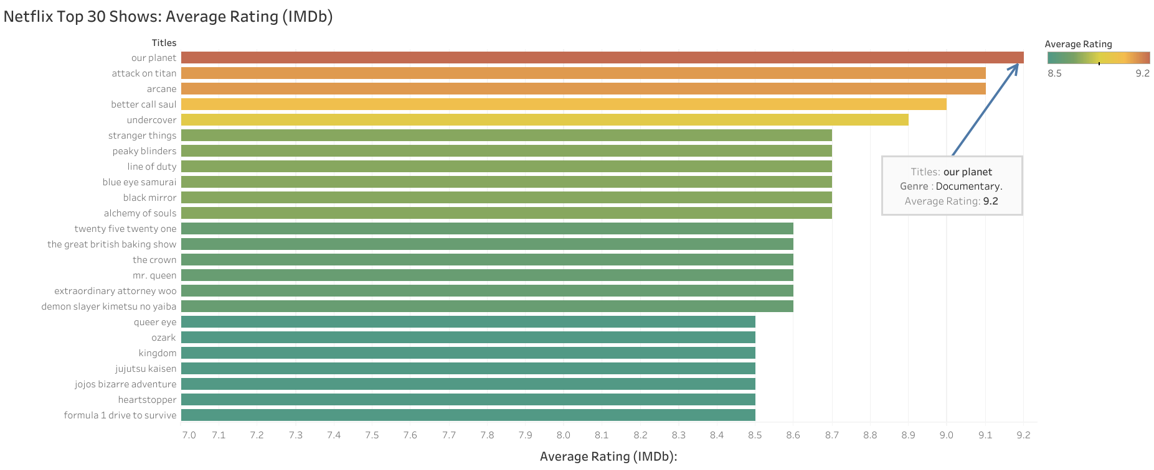
Top 30 Shows (IMDb rating)

Slide 8
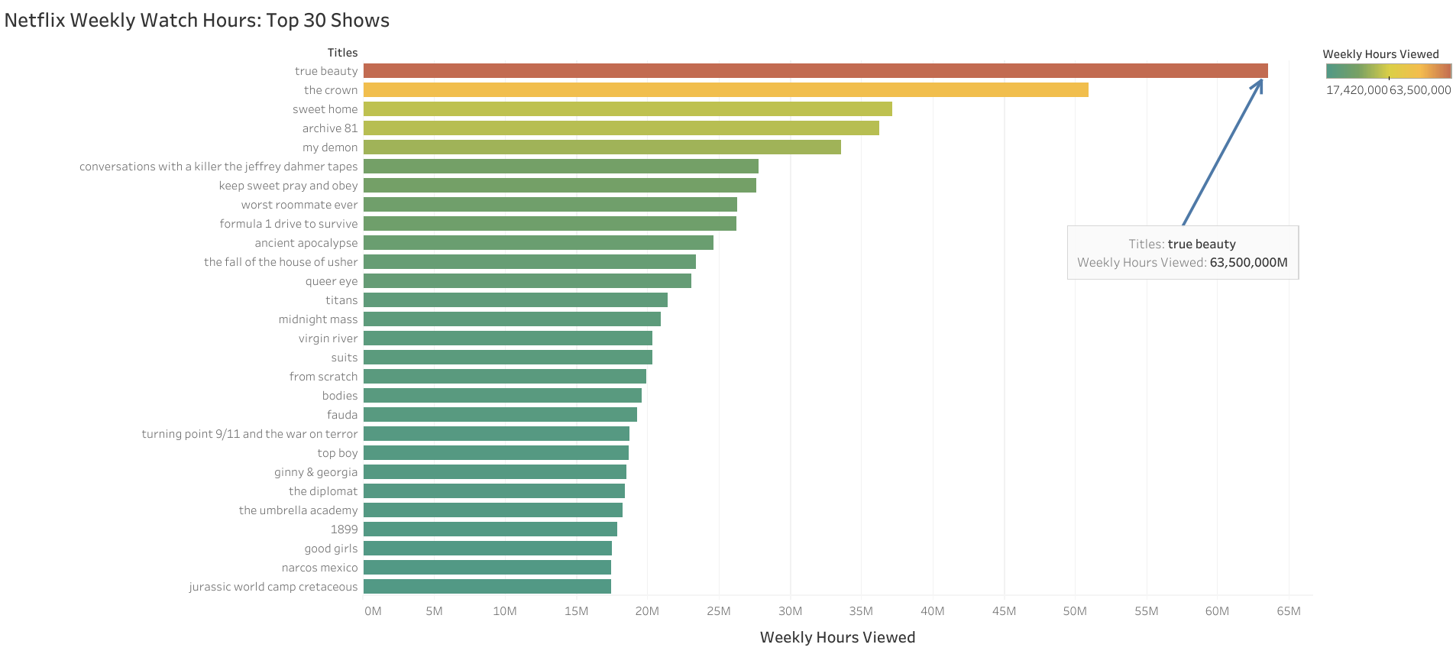
Top 30 Shows (Weekly watch hours)

Slide 9
Top 30 Shows (graphs):
IMDb rating vs Weekly watch hours
Key Insight: Differentiated strategies are needed for critically acclaimed vs. popular shows.

Slide 10
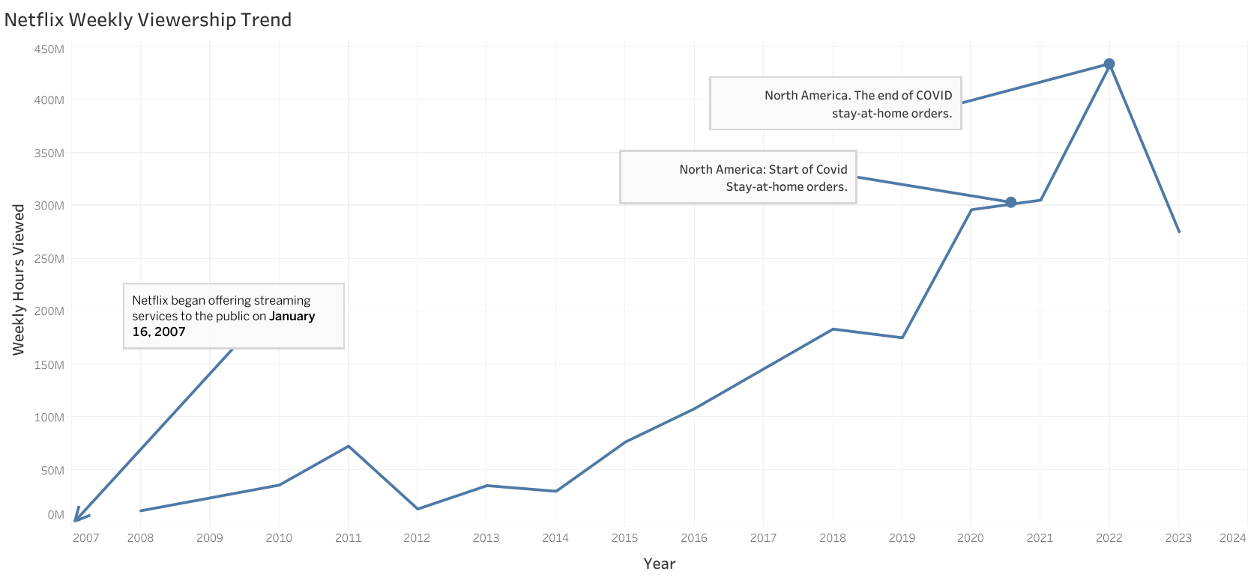
Viewership Trends Overtime

Slide 11
Viewership Trends Overtime:
Analysis :
Trend Up to 2022
Significant correlation with the pandemic (2020–2022). Lockdowns created a boom in streaming as people spent more time at home.
Netflix capitalized by releasing high-volume, diverse content during this period.
Post-2022 Drop-Off:
Ease of restrictions reduced time spent indoors
Intense competition from platforms like Disney+ and HBO Max contributed to a decline.
Audience fatigue with Netflix’s existing content offerings.

Slide 12
Viewership Trends Overtime:
Recommendation :
Counteract drop-off by diversifying genres, leveraging untapped markets, and improving catalog curation.

Slide 13
Insights and Correlations:
Key Observations:
Mass appeal genres like Drama/Romance drive high engagement.
Niche genres like Documentary require stronger marketing.
Pandemic-related surges highlight the value of strategic releases during global events.
Correlations:
High ratings ≠ high viewership (e.g., "Our Planet" vs. "True Beauty").
Viewer habits are influenced by external factors (pandemics, competition, etc.).

Slide 14
Recommendations:
For Netflix:
Invest More in Popular Genres:
Drama?Romance for Sustained Engagement,
Leverage Trends:
Documentaries, Marketed to Specific audience segments.
Explore Emerging Markets:
Global expansions in untapped regions.
Combat Competition
Unique Offerings (e.g., interactive shows, limited series)

Slide 15
Conclusion:
Recap Findings:
Genre Performance, Viewer Trends, and Correlations.
Recommendations for Content Strategy
Closing Statement:
Data-Driven content decisions will help Netflix maintain its competitive edge

Slide 16
Datasets Used:
Datasets:
IMDb Top Rated Titles (Movies & TV Series)** (`data.csv`)
Provides metadata about TV shows and movies, including genres, ratings, and popularity.
Netflix Movies and TV Shows** (`netflix_titles.csv`)
Includes details about titles available on Netflix, such as genre, duration, and release year.
Official Netflix Viewership Database** (`most_popular.csv`, `all_weeks_countries.csv`, `all_weeks_global.csv`) Provides weekly views in hours, highlighting popular Netflix titles.

Slide 17
Tools Used:
Excel/Google Sheets:
For data cleaning and standardization.
Rstudio
For data merging and cleaning.
Tableau Studio
For data visualization.

Slide 18
THANK YOU

